Slide 1
Strategies to improve students’ memory skills

Slide 2
What is the relevance of memory skills in the new curriculum?
Linear curricula at GCSE and A Level focused on extended recall
More content in curricula KS1-5
New Grade 9 at GCSE (top 3% of students)
Focus on ‘mastery’ in subjects
Ofsted focus on subject knowledge
Link between knowledge and skills: The richer the knowledge base of the curriculum, the most effectively cognitive processes can operate (Willingham)

Slide 3
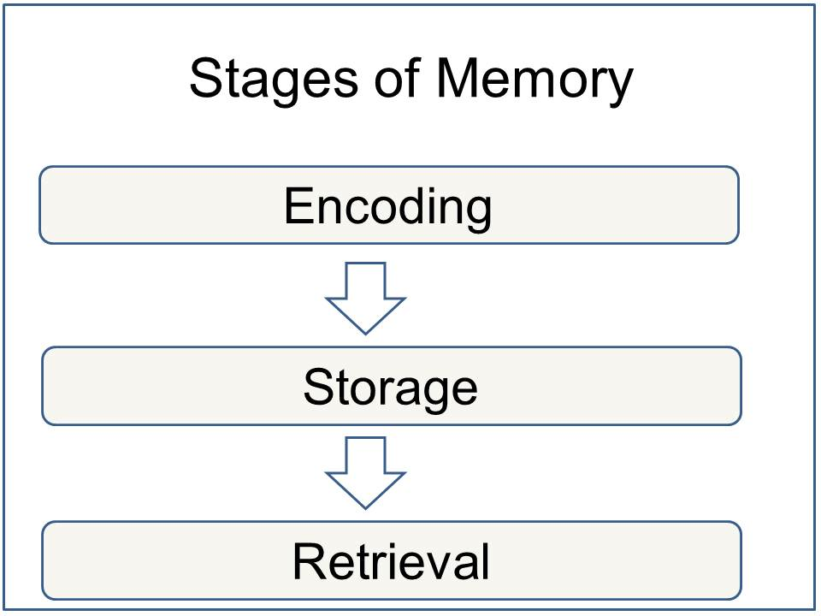

Slide 4
Teaching for Memory Encoding
We remember what we think about (Willingham)
Chunking: students remember beginnings and ends (Alistair Smith)
Multiple exposures: students need 3-4 exposures to information over time (Hattie)
Overlearning: Overlearn the material by 20%. Studies show that adults and children are over-confident in predicting what they know (Willingham)
Spreading activation models (Collins and Loftus): develop associative networks
Spaced learning (Fields): rapid structured repetition embeds long term memory and creates neural pathways. This has an effect size of 0.71
Input 1: Teacher-led e.g. Power Point
Input 2: Student recall activity
Input 3: Application
Immersion Learning: displaying key words at key level improves student recall by up to 70% (Jenson)
Attention Activities: we remember what we pay attention to (Willingham)
Meaning Activities: learning tasks which force students to think about meaning (because it’s meaning that we want them to remember) e.g. Explanations, re-formatting information (Willingham)
Worked Examples: reduce cognitive overload by freeing the memory to look at solution steps e.g. Comparing, criticising, improving or annotating models
Generating information is more memorable than just reading it

Slide 5
Resources for memory encoding
Thinglink: Allows users to create interactive memory boards
Diigo: Allows users to collect, organise, link and annotate information
Showme: Allows you to capture teaching which can then be replayed (portable learning)
Studyblue: Allows users to create notes and flashcards

Slide 6
Retrieval Enhanced Teaching
Build in retrieval practice
Distinctive cues e.g. mnemonics
Distributed study over time
Mixed practice is better preparation for tests than blocked practice
Interleaved assessment
Frequent low-stakes quizzes
Socrative: A way of questioning and assessing students using devices for immediate feedback on understanding and recall
Memrise: Allows users to create their own interactive quizzes to memorise key facts
Quizlet.com: Allows users to build quizzes, flashcards and study tools
Using memory retrieval practices regularly improves memory
Tests don’t just measure learning they solidify it

Slide 7
What works?
Dunlowsky (2013) ranks retrieval strategies from most to least effective:
Practice tests (and corrective feedback after tests)
Distributed practice: study activities spread over time
Interleaved practice: intermixing content
Elaborative interrogation: generating an explanation for why a fact or concept is true
Self-explanation: explaining how new information relates to known information or steps taken during problem solving
Re-reading
Highlighting and underlining
Summarising
Mnemonics: using key words to associate verbal material
Imagery of text: forming mental images of text materials
In order to be effective, strategies need to avoid “shallow repetition” without thinking about meaning (Willingham)

Slide 8
Quizzes work better than more study sessions Roediger & Karpicke 2006 identified the Testing Effect
Study | Study | Study | Study | Test
Study | Study | Study | Test | Test
Study | Study | Test | Test | Test
Study | Test | Test | Test | Test
Testing can be used as teaching
Testing strengthens students’ retrieval pathways
Students become more aware of what they don’t know (Roediger, Putman & Smith 2011)
Putwain (2008) showed that test anxiety had a negative impact on GCSE results. Regular low-stake testing makes students less anxious about tests (Brown, Roediger & McDaniel 2014)

Slide 9
Whole-school Planning for Retrieval Enhanced Learning
Increase the amount of review in lessons and planning schedules
Retrieval Planning Schedules adding in spacing, interleaving and low-stake testing
Retrieval Lesson Plans
Starter/ plenary quizzes
(last lesson, last week, last term, connect)
Develop memory questioning
Replace ‘revision’ with ‘review’ in planning
Review tutorials: once a week in form time
Book polishing built into planning schedules
Students encouraged to use technology available
Study regimes for students incorporating spacing and interleaving

Slide 10
Coaching for Memory Skills
Student memory champions
Staff memory mentors
Memory Days
Memory form tutorials
Memory Challenges/ Master Memory

Slide 11
Worth considering?
Research suggests that Times New Roman size 12 is the fastest font to read
Listening to classical music can increase concentration
Practising meditation can increase focus

Slide 12
Resources & Experts
Exemplar Retrieval Planning Schedule
Exemplar Retrieval Lesson Plan
How to Book Polish
www.lovelearningideas.com
Make it Stick (2014) Brown, Roediger and McDaniel
Bjork
Willingham

