Slide 1
How to pass exams

Slide 2
Memory skills are vital to passing exams
Linear exams at GCSE and A Level focused on extended recall
More content in curricula from KS1-5
New Grade 9 at GCSE (top 3% of students)
New focus on ‘mastery’ in subjects

Slide 3
What’s the science?
The brain contains working memory (a bottleneck that is fixed, limited and easily overloaded), and long-term memory (a storehouse that is almost unlimited). If nothing has changed in the long-term memory, nothing has been learned.
There is a link between knowledge and skills: The richer your knowledge base, the more effectively your thinking processes can operate.
Having factual knowledge in the long-term memory makes it easier to acquire still more factual knowledge.
(Willingham)

Slide 4
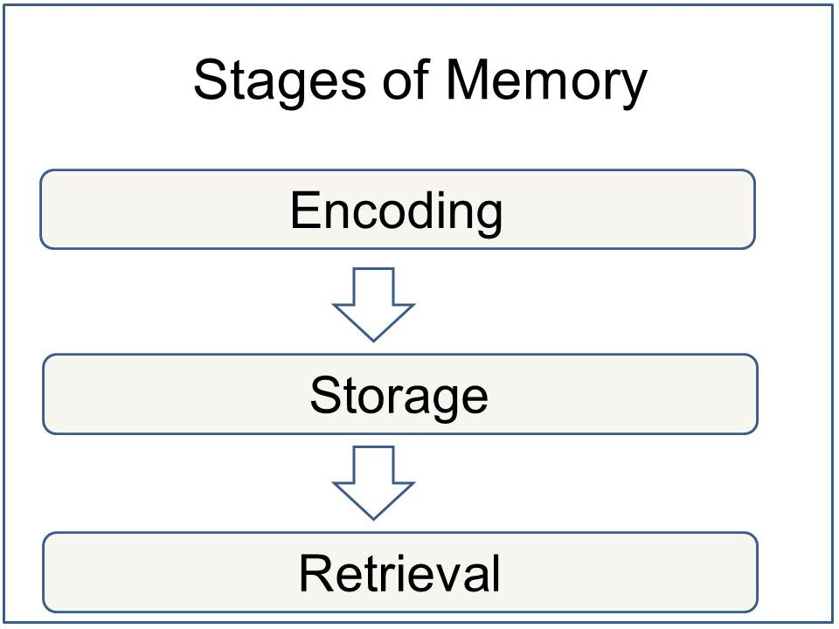

Slide 5
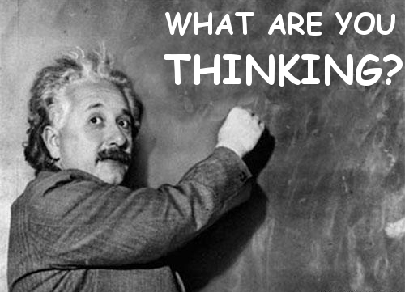
What works: 1
We remember what we think about so you need to spend time actively thinking about what you want to learn. How are you going to do this?
Walk while you learn
Talk it through
Listen to your learning
Watch your learning
See your learning
Write down your learning

Slide 6
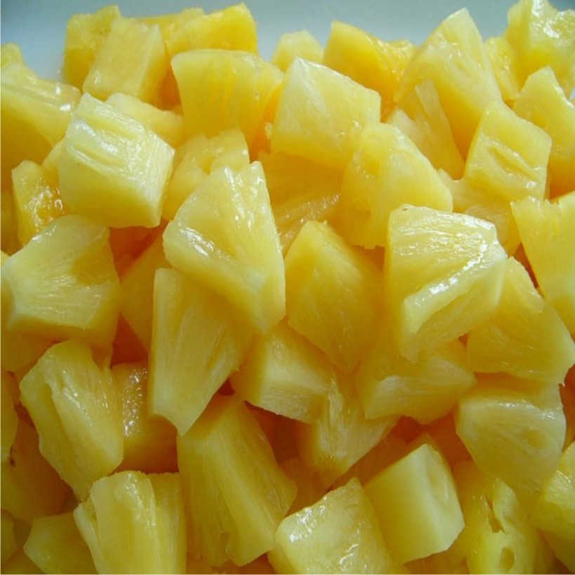
What works: 2
We remember beginnings and endings better so you need to chunk up what you want to learn into bite size bits. How are you going to do this?
Flash cards
Lists

Slide 7
What works: 3
We need 3+ exposures to information to learn it, and we learn best when we space out learning so you need to ensure that you plan to come back to each chunk of learning 3 times over a period of weeks. Spaced Learning is the NO. 2 most effective thing that you can do to learn. How are you going to do this?
Cramming learning into a couple of days does NOT transfer it to your long term memory so you will lose it.

Slide 8
What works: 4
Mixed practice is better, more realistic, preparation for the exam than blocked practice. This is the NO. 3 most effective thing that you can do, so mix up your content and questions rather than learning in blocks. How are you going to plan for this?

Slide 9
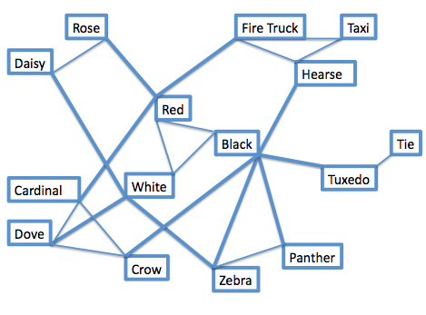
What works: 5
We learn by connecting information to what we already know. Spreading Activation Models can help with this. How are you going to use them?

Slide 10
What works: 6
Immersion Learning can improve retention by up to 70%. How are you going to immerse yourself in what you need to learn?
Bedroom walls and ceiling
Screen display

Slide 11
What works: 7
It frees up memory space if you practice on worked examples rather than solving problems from scratch so concentrate your revision practice on worked examples.

Slide 12
What works: 8
Generating information is more memorable than reading it. These strategies are effective because they help you to think about the meaning of what you are trying to learn. How are you going to use them?
Elaborative interrogation: generating an explanation for why a fact or concept is true
Self-explanation: explaining how new information relates to known information or steps taken during problem solving

Slide 13
What works: 9
You need distinctive cues to help you to retrieve information that is stored in your long term memory:
Mnemonics
Method of Loci: Memory Palaces

Slide 14
What works: 10
Studies show that regular, low-stake testing is the NO. 1 way of learning because it strengthens your retrieval pathways. Regular testing also makes you less anxious about the exam; therefore testing yourself should be your main form of revision. How are you going to do this?
“Basically, any time that you, as a learner, look up an answer or have someone tell or show you something that you could, drawing on current cues and your past knowledge, generate instead, you rob yourself of a powerful learning opportunity.” Bjork

Slide 15
What works: 11
Studies show that we are overconfident about what we will actually remember. You need to overlearn by 20%. How are you going to do this?

Slide 16
Worth considering?
Research suggests that Times New Roman size 12 is the fastest font to read
Listening to classical music can increase concentration
Practising meditation can increase focus

Slide 17
Resources for memorising
Thinglink: Allows users to create interactive memory boards
Diigo: Allows users to collect, organise, link and annotate information
Showme: Allows you to capture teaching which can then be replayed (portable learning)
Studyblue: Allows users to create notes and flashcards
Socrative: A way of questioning and assessing students using devices for immediate feedback on understanding and recall
Memrise: Allows users to create their own interactive quizzes to memorise key facts
Quizlet.com: Allows users to build quizzes, flashcards and study tools

